Slide 1

Industrial Cum Software Training
Session Jan-June 2026
INFOTECHMON PVT LTD, MOHALI:
Presented By : GURJOT SINGH KALSI
Department : COMPUTER SCIENCE & ENGINEERING
Roll Number : 2232098

Slide 2
LLM-Based Contextual Sentiment Analysis and Data Intelligence System
Faculty Mentor Name : Anmol rana
Designation : python instructor
Organization : Infotechmon
Supervisor Name :
Designation :
Organization :

Slide 3
Profile of Industry
The project belongs to the LLM-powered Data Analytics industry
Uses Large Language Models (LLMs) to automate data interpretation
Combines:
Natural Language Processing (NLP)
Database querying (SQL)
Used in:
Customer feedback analysis
Business intelligence dashboards
Represents a shift from manual analytics → AI-assisted analytics systems

Slide 4
Description of Technical Departments of organization
Infotechmon Private Limited (ITM) is an ISO 9001:2015 certified technology solutions provider and industrial training institution based in Mohali. We bridge the gap between academic learning and industry requirements through high-end software development services and comprehensive technical education.
Software & Web Engineering: Specializing in Full Stack Development, Custom Web Designing, E-commerce solutions, and CMS development.
Digital Intelligence & Marketing: Focused on Search Engine Optimization (SEO), Social Media Marketing, and data-driven digital growth strategies.
Industrial Automation & Core Engineering: Providing specialized technical solutions and training in MATLAB, IoT, Robotics, and Embedded Systems.
Design & Infrastructure: Expertise in CAD/CAM/CAE tools, including AutoCAD, Revit, ANSYS, and CATIA for mechanical and civil architecture.

Slide 5
Introduction to Software
Gemini 2.5 Flash LLM (Core Intelligence Engine)
Performs:
Sentiment analysis
Insight generation
Fast response, suitable for real-time analytics
Python + FastAPI
Manages LLM requests and system workflow
Handles API calls and processing logic
PostgreSQL
Stores structured outputs from LLM
Enables SQL-based analysis
Redis
Caches intermediate states for faster processing
MinIO
Stores dataset files separately (CSV, text data)
React + Vite
Displays results visually to user

Slide 6
Introduction to Project
This project is an LLM-based data analytics system using Gemini 2.5 Flash
Designed to convert raw datasets into meaningful insights automatically
Workflow:
User uploads dataset
Data is stored and processed
LLM analyzes text records
System generates:
Sentiment labels
Analytical insights
Combines LLM reasoning + SQL querying + visualization

Slide 7
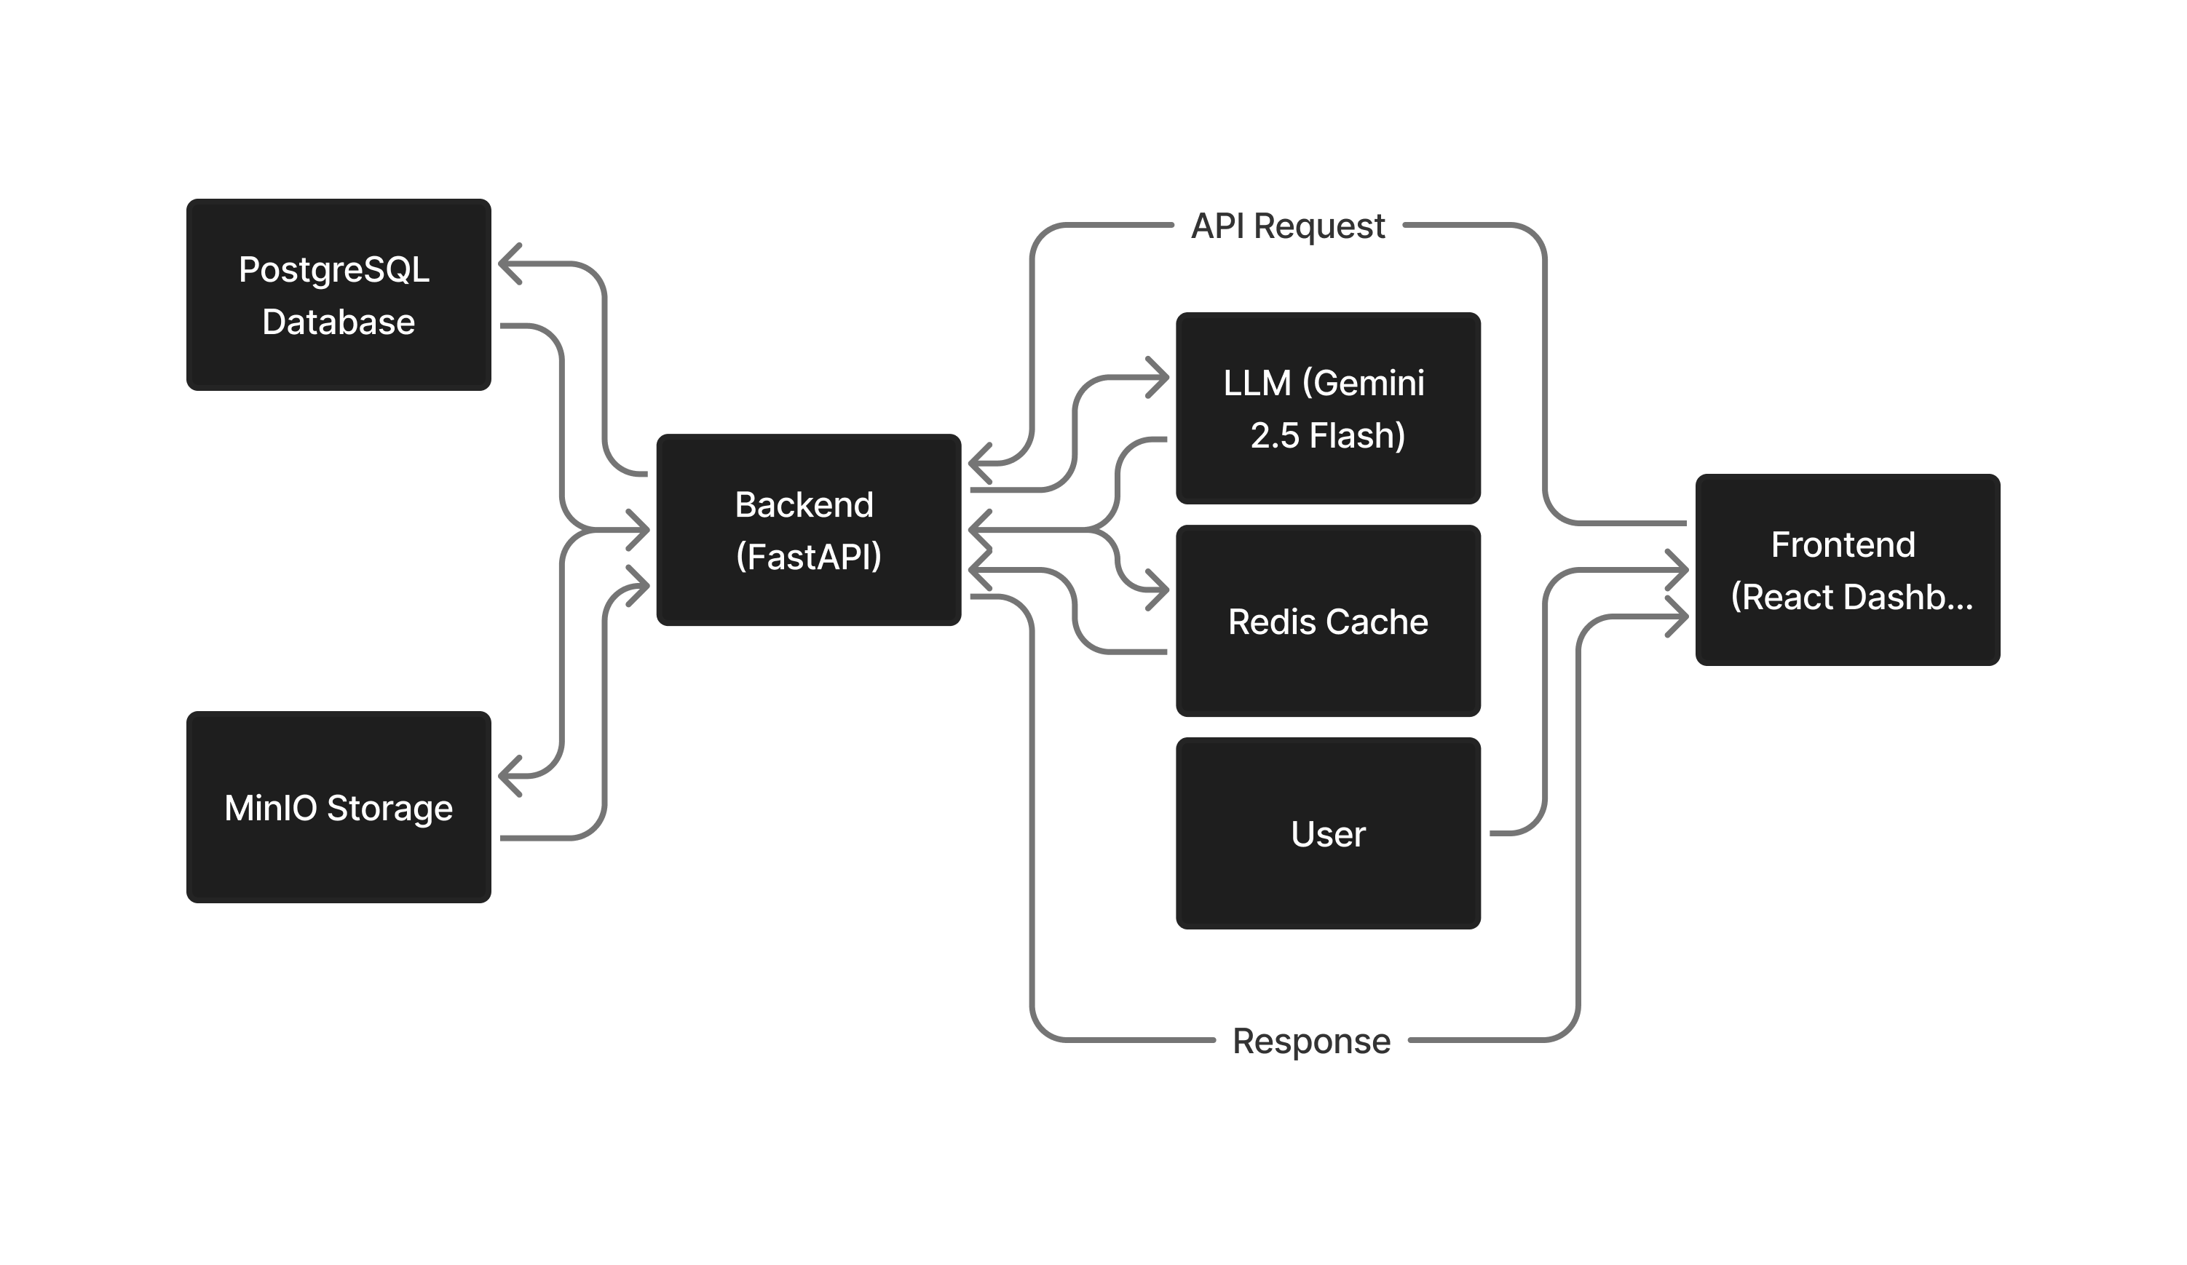
DFD’s / ER Diagram

Slide 8
Description of Modules
User Module
Authentication and session handling
Dataset Storage module
Uploads dataset
Stores file in MinIO
Tracks dataset status
Record Extraction Module
Splits dataset into individual text records
Prepares data for LLM processing
LLM Analysis Module (Core)
Sends records to Gemini 2.5 Flash
Generates:
Sentiment context-aware sentiment (positive / negative / neutral / nuanced / custom)
Confidence score Softmax based.
Stores structured results

Slide 9
Description of Modules
SQL Analytics Module
Queries database to compute:
Sentiment distribution
Aggregated insights
Visualization Module
Uses charts to display results
Example: sentiment percentage graphs
Storage Module
MinIO → raw data
PostgreSQL → processed data

Slide 10
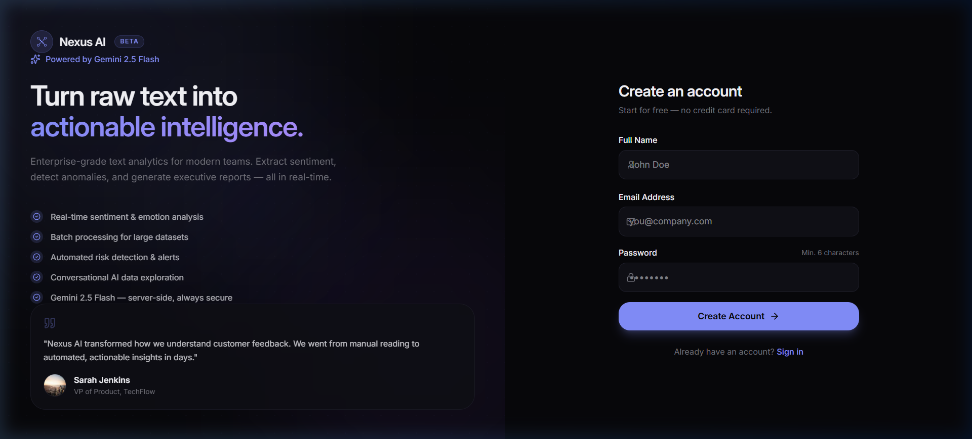
Screenshots

Slide 11
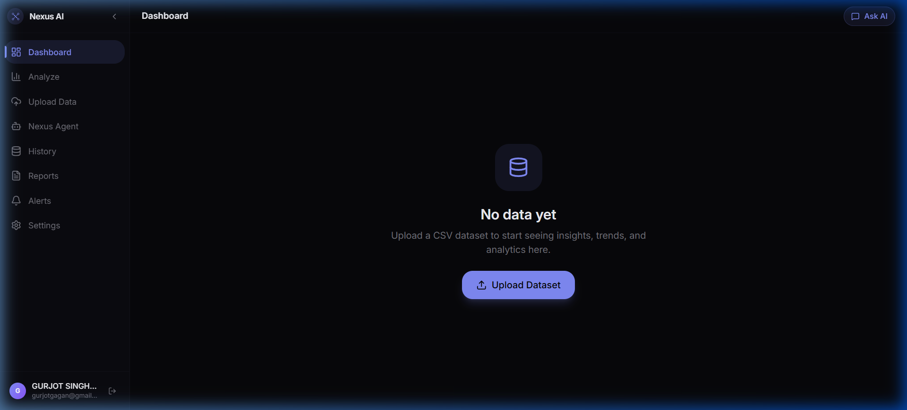
Screenshots

Slide 12
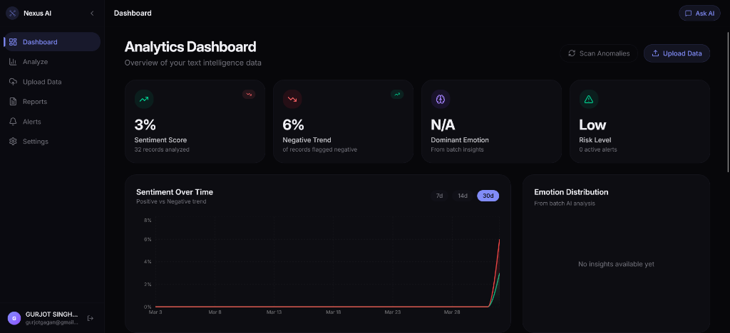
Screenshots

Slide 13
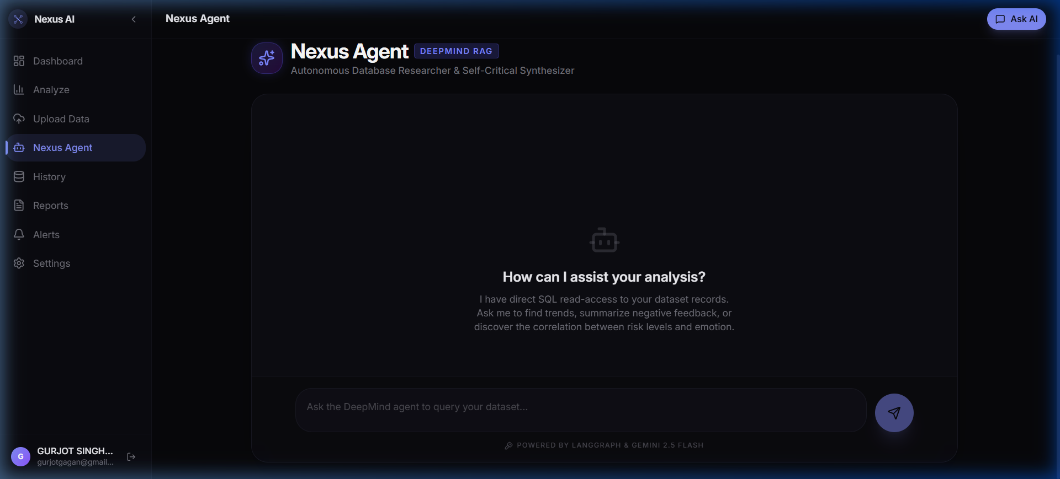
Screenshots

Slide 14
Limitation of Project
Context Window Size Limited by LLM token capacity; long documents may require batch processing.
Real-Time Processing High latency in large datasets due to complex LLM inference and multi-step agent reasoning.
Dependence on Training Data Performance may degrade on out-of-domain or niche topics without fine-tuning.
Resource Intensity High computational cost for LLM inference and storage of embeddings and cache.

Slide 15
Conclusion & Future Scope
Conclusion
This project develops an LLM-based data analytics system using Gemini 2.5 Flash to automate sentiment analysis and insight generation from datasets. It integrates LLM processing with SQL storage and dashboard visualization, reducing manual analysis effort.
Future Scope
Add parallel/batch processing
Improve context-aware analysis
Integrate Fine tuned LLM models
Handle large/noisy datasets better
Extend to advanced analytics
Enable scalable cloud deployment

Slide 16
Bibliography / References
Vaswani, A., et al. (2017). Attention Is All You Need. Advances in Neural Information Processing Systems (NeurIPS).
Devlin, J., Chang, M. W., Lee, K., & Toutanova, K. (2018). BERT: Pre-training of Deep Bidirectional Transformers for Language Understanding. arXiv:1810.04805.
Brown, T. B., et al. (2020). Language Models are Few-Shot Learners. Advances in Neural Information Processing Systems (NeurIPS).
Medhat, W., Hassan, A., & Korashy, H. (2014). Sentiment Analysis Algorithms and Applications: A Survey. Ain Shams Engineering Journal.
Young, T., Hazarika, D., Poria, S., & Cambria, E. (2018). Recent Trends in Deep Learning Based Natural Language Processing. IEEE Computational Intelligence Magazine.

